Slide 1
SMArT User Guide
For FSAL
Draft Version

Slide 2
Agenda
SMArT Overview
Site Activation Plan
High Level Modeling Solver
Exporting Data
Feedback & Support
Appendix

Slide 3
SMArT Overview

Slide 4
SMArT Overview
Study Modeling Arc Tool is a web-based Spotfire tool developed by OARS
Purpose
Self-service tool for the development of high-level site activation plans and enrollment scenarios to obtain initial study level enrollment insights. This tool serves as a pre-cursor to DVSO detailed planning.
Objective
Achieve greater efficiency, transparency and autonomy in the determination of assumptions for study level enrollment modeling
In Scope |  | Out of Scope
All registry non-cohort studies prior to the development of a high level historical scenario |  | Studies with > 5 planned non-preferred countries Studies not using Pfizer historical start-up timelines for their high-level site activation schedule Cohort studies Modeling of historical enrollment scenario for MindTheGap analysis
Users
Feasibility Strategy & Analytics Lead (FSAL), Performance Analyst (PA)

Slide 5
SMArT Scope of Usage
When? | At early stage of a study enrollment modeling
Why? | To assess and refine study assumptions that will be used to develop DVSO High Level historical scenario
Study assignment
Historical analysis
Country outreach
Mind The Gap analysis
Governance endorsement
SMArT HL Scenario
DVSO HL Historical Scenario
DVSO Detailed Scenario

Slide 6
SMArT Overview
Link to SMArT: Study Modeling Arc Tool (SMArT)
SMArT is comprised of 5 views
Feedback | This view contains the link to a form to capture feedback, enhancement requests & bug fixes request for the tool
Site Activation Plan | This view is where the user captures inputs to develop high-level site activation plans
DVSO Activation Schedule High Level Inputs | This view contains exportable site activation plan data tables formatted for DVSO input
High Level Modeling Solver | This view is where the user develop captures inputs to develop study level enrollment plans
Activation Plan Audit Table | This view is the audit track of all saved actions in the tool

Slide 7
Site Activation Plan

Slide 8

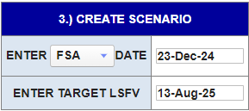
Site Activation Plan Inputs
Locate the study from SELECT STUDY dropdown or start typing a study ID to filter down to your study of interest. Only studies loaded in the Registry will be found in this list. If the scenario is for early planning or program-level planning w/ no protocol ID available, use the *Placeholder* option.
Choose an anchor date of FAP, CTA or FSA from the dropdown and enter the date. If FSFV is given as the anchor date, subtract the number of days between FSA-FSFV from the FSFV date to get the FSA date that should be entered.
Enter the study TARGET LSFV date. This date is used to determine the approximate enrollment period and color code the country timelines to show which of the selected countries will have sites activated in time to contribute to enrollment. The minimum recruiting days is set to 90 days in the tool.

Slide 9
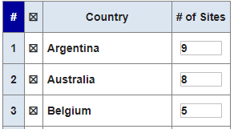
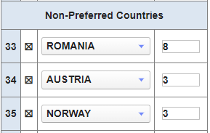
Site Activation Plan Inputs
To add a preferred country to the plan, change the ‘0’ in the # of Sites column for the country to a value of 1 or greater. Doing this will also X mark the study to the left automatically. Click out / into another field for the new entry to be read and loaded into the plan.
To add a non-preferred country to the scenario, select it from the available list and then enter the number of sites. Up to 5 non-preferred countries can be included to a plan.
To remove a country from the footprint, either change the # of Sites value to 0, or click on the X to the left of the country name.
The scenario will immediately update (after a brief loading period) each time a country is added or removed, including the overall scenario site total.

Slide 10

Site Activation Plan Inputs
Once the plan is finalized, enter a new plan name and press Save. The name should be as descriptive as possible, but does not need to include study ID, date, time, and NTID info as this is tagged automatically by the tool. If the *Placeholder* Study is used, the identifying program or asset should be included, if possible.
If revisions to this plan need to be made to correct a mistake, locate the scenario in the ‘Select Previous Scenario’ dropdown, make the required changes, and press Save. A separate plan will be saved with the same name, but an updated time/date stamp so it is clear which is most current.
To use an existing plan as a base template to create an additional plan, locate the scenario in the Select Scenario dropdown, make the required revisions, change/update the plan name in the ‘Enter New Plan Name’ field, and then press Save.

Slide 11
High Level Modeling Solver

Slide 12
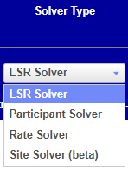
Types of Solver
SMArT High Level Modeling Solver can solve for different variables, given a set of inputs. Only one variable can be solved at a time.
LSR: Solve for the date of study last subject randomized
Enter randomization rate, recruitment reduction factor (0-100), and target # of participants
Participant: Solve for the study total number of participant randomized
Enter randomization rate, recruitment reduction factor (0-100), and LSR date
Rate: Solve for the study randomization rate in subject per site per month or in subject per site per day
Enter recruitment reduction factor (0-100), target # of participants, and LSR date
Site: Solve for the study total number of sites needed
Enter randomization rate, recruitment reduction factor (0-100), target # of participants, and LSR date

Slide 13
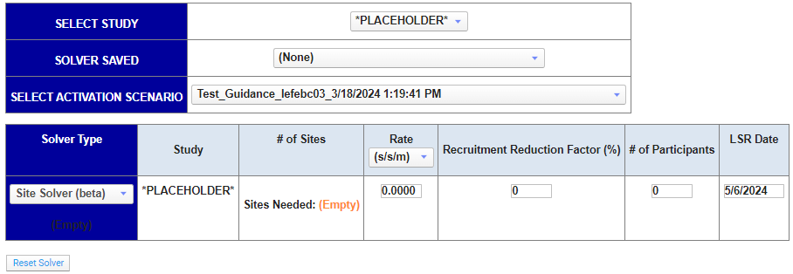

Reset and Save Plans
At any time you can reset the entries in the solver to clear all entries, using the “Reset Solver” button
To save a high level enrollment plan, enter a plan name and click the SAVE button

Slide 14
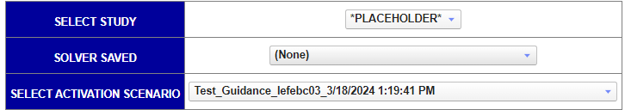


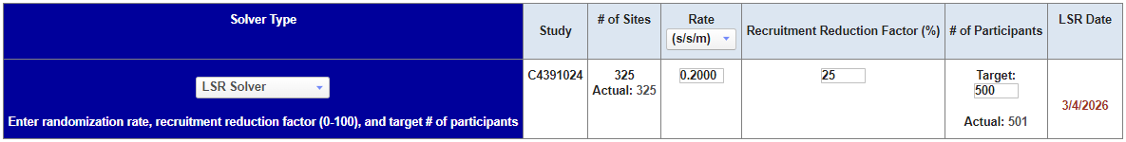
High Level Modeling LSR Solver Inputs
Locate the study from SELECT STUDY dropdown or start typing a study ID to filter down to your study of interest.
Use the ‘Solver Saved’ dropdown to select a previous enrollment plan
Use the ‘Select Activation Scenario’ dropdown to select a previously created site activation plan
Select the LSR Solver Type from the dropdown
Select the Rate unit using the dropdown
Subject/site/month (s/s/m) or subject/site/day (s/s/d)
Enter the randomization Rate
Enter the Recruitment Reduction Factor %
This value is the reverse of the Site Actively Screening (SAS)%. For example, if the planned SAS is 75%, you will put in 25% in that field. Also, you need to put in 25 and not 0.25.
Enter the study target # of participants
SMArT is not using Screen Failure Rate (SFR), so no screening information is available. If you need to know the number of subjects screened, you will need to calculate it manually
# Screened = # Randomized / (1 - SFR%)

Slide 15
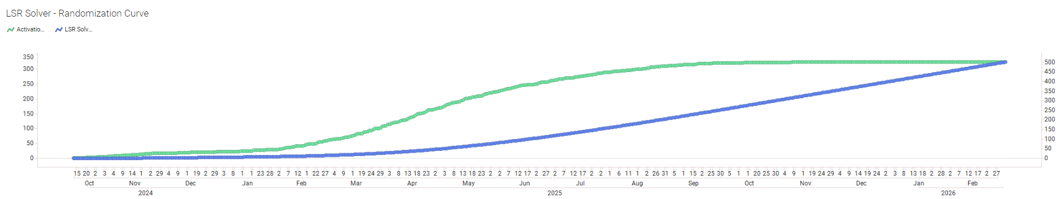
High Level Modeling LSR Solver Outputs
The solved variable (LSR date) appears in RED
The Randomization and Site Activation curves are represented on a graph

Slide 16

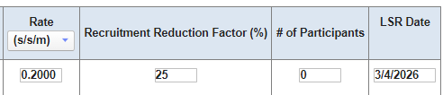
High Level Modeling Participants Solver Inputs
Locate the study from SELECT STUDY dropdown or start typing a study ID to filter down to your study of interest.
Use the ‘Solver Saved’ dropdown to select a previous enrollment plan
Use the ‘Select Activation Scenario’ dropdown to select a previously created site activation plan
Select the Participant Solver Type from the dropdown
Select the randomization Rate unit using the dropdown
Subject/site/month (s/s/m) or subject/site/day (s/s/d)
Enter the randomization Rate
Enter the Recruitment Reduction Factor %
This value is the reverse of the Site Actively Screening (SAS)%. For example, if the planned SAS is 75%, you will put in 25% in that field. Also, you need to put in 25 and not 0.25.
Enter the study LSR Date
Leave # of Participants field blank

Slide 17
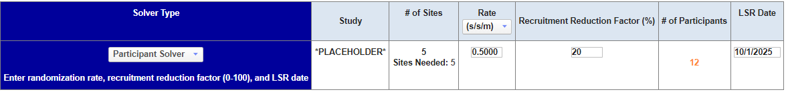
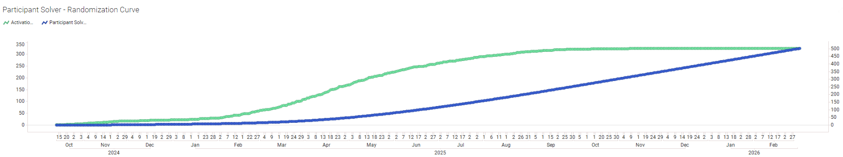
High Level Modeling Participants Solver Output
The solved # of Participants appears in ORANGE
The Site Activation and Randomization curves are represented on a graph

Slide 18

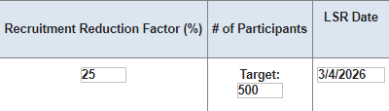
High Level Modeling Rate Solver Inputs
Locate the study from SELECT STUDY dropdown or start typing a study ID to filter down to your study of interest.
Use the ‘Solver Saved’ dropdown to select a previous enrollment plan
Use the ‘Select Activation Scenario’ dropdown to select a previously created site activation plan
Select the Rate Solver Type from the dropdown
Enter the Recruitment Reduction Factor %
This value is the reverse of the Site Actively Screening (SAS)%. For example, if the planned SAS is 75%, you will put in 25% in that field. Also, you need to put in 25 and not 0.25.
Enter the study # of Participants Target
Enter the study LSR Date

Slide 19
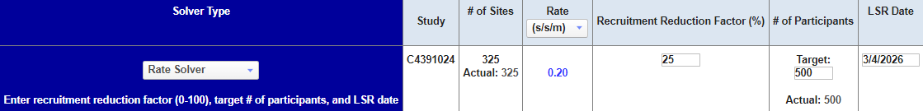

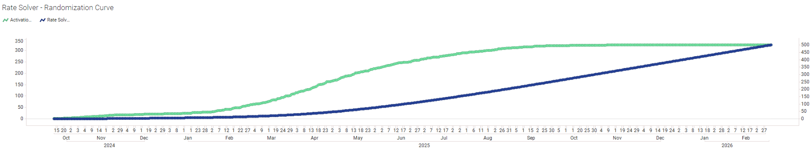
High Level Modeling Rate Solver Output
The solved variable (Rate) appears in BLUE. Select the Rate unit using the dropdown.
The Site Activation and Randomization curves are represented on a graph

Slide 20
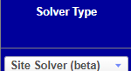

High Level Modeling Site Solver Inputs
Locate the study from SELECT STUDY dropdown or start typing a study ID to filter down to your study of interest.
Use the ‘Solver Saved’ dropdown to select a previous enrollment plan
Use the ‘Select Activation Scenario’ dropdown to select a previously created site activation plan
Select the Site Solver Type from the dropdown
Select the randomization Rate unit using the dropdown
Subject/site/month (s/s/m) or subject/site/day (s/s/d)
Enter the randomization Rate
Enter the Recruitment Reduction Factor %
This value is the reverse of the Site Actively Screening (SAS)%. For example, if the planned SAS is 75%, you will put in 25% in that field. Also, you need to put in 25 and not 0.25.
Enter the study # of Participants
Enter the study LSR Date

Slide 21
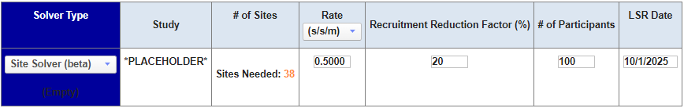
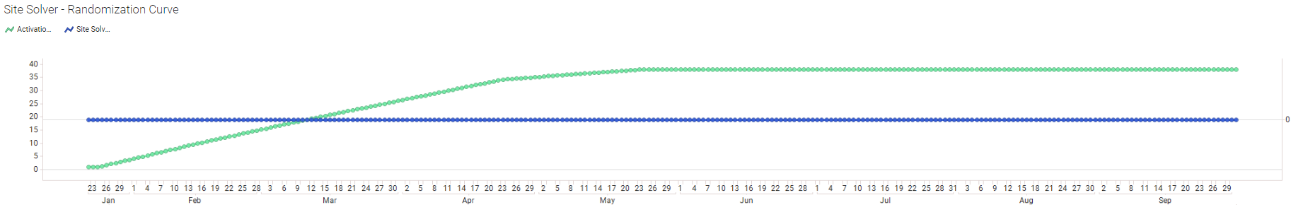
High Level Modeling Site Solver Output
The solved # of sites needed appears in ORANGE
The Site Activation curve and number of sites needed are represented on a graph

Slide 22
Exporting data

Slide 23
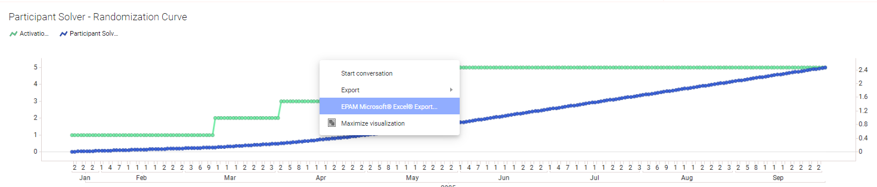
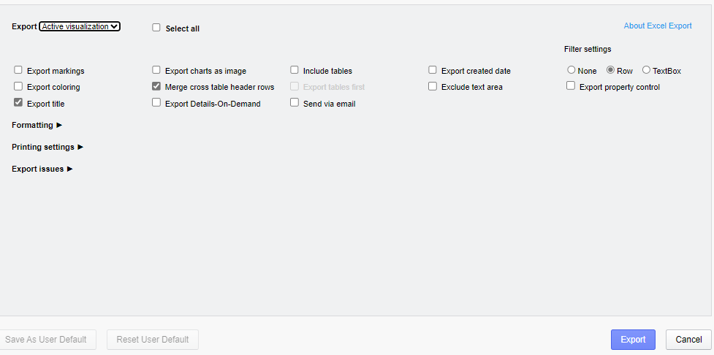

Exporting Data from SMArT
Right click on any table or graph of the tool
Select ‘EPAM Microsoft Excel Export, then click Export on the opened option tile
There is also a tab named ‘Smart Desired Output for additional data and export options

Slide 24
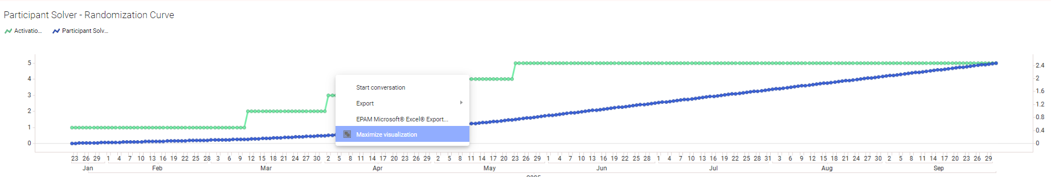
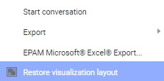
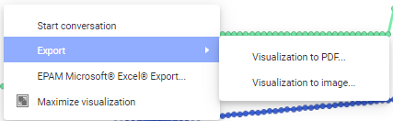
Exporting Visuals from SMArT
Right click on any graph of the tool
You can select ‘Maximize visualization’ to expand the graph and ‘Restore visualization layout to reduce it
Select ‘Export’ for visualization output options (PDF or png)

Slide 25
Feedback and Support

Slide 26



Feedback and Support
Feedback
Support
Use the Feedback view to log feedback, enhancement requests, and report bugs to the SMArT Feedback Form
Address questions and training needs to the Performance Analyst assigned to the study

Slide 27
Appendix

Slide 28
SMArT Terms definitions
List of acronyms, abbreviations, terms used in SMArT and their definition
Term | Definition
FAP date | Final Approved Protocol date
CTA date | Clinical Trial Application: the start date of the CTA process. The date the last document in English to be sent to the country to begin the Regulatory and Ethics process.
FSA | First Site Activated: the date on which the first site is ready to enroll participants
LSFV date | Last Subject First Visit: the date on which the last participant have their screening visit
P25/P50/P90/P100 | The number of days between the first site activated date and 25%/50%/90%/100% of sites activated date
P25/P50/P90/P100 Date | The date on which 25%/50%/90%/100% of sites are activated
LSR date | Last Subject Randomized: the date on which the last participant have their randomization visit
Rate | Randomization rate
s/s/m | subject/site/month
s/s/d | subject/site/day
Term | Definition
Activations | Number of sites activated
LSR Solver | Solve for the date of study last subject randomized
Participant Solver | Solve for the study total number of participant randomized
Rate Solver | Solve for the study randomization rate in subject per site per month or in subject per site per day
Site Solver | Solve for the study total number of sites needed
Screening Period | Per the study protocol, the maximum number of days allowed between the screening and randomization visits

